Slide 1
PHP Login System with E-Commerce Style Dashboard
Name : MADDI VENKATA TEJA
Internship: Web Development Internship
Organization: SNS Infotech Innovations Private Limited
Technologies: PHP, MySQL, HTML, CSS, XAMPP

Slide 2
Project Overview
This project implements a login authentication system
using PHP and MySQL.
After successful login, users are redirected to a
professional dashboard similar to an e-commerce admin panel.
Features:
• Secure Login
• Dashboard Interface
• Product Listing
• Add to Cart
• Cart Management
• Logout System

Slide 3
Technologies Used
Frontend
• HTML
• CSS
• Font Awesome
Backend
• PHP
Database
• MySQL
Tools
• XAMPP
• VS Code
• phpMyAdmin

Slide 4
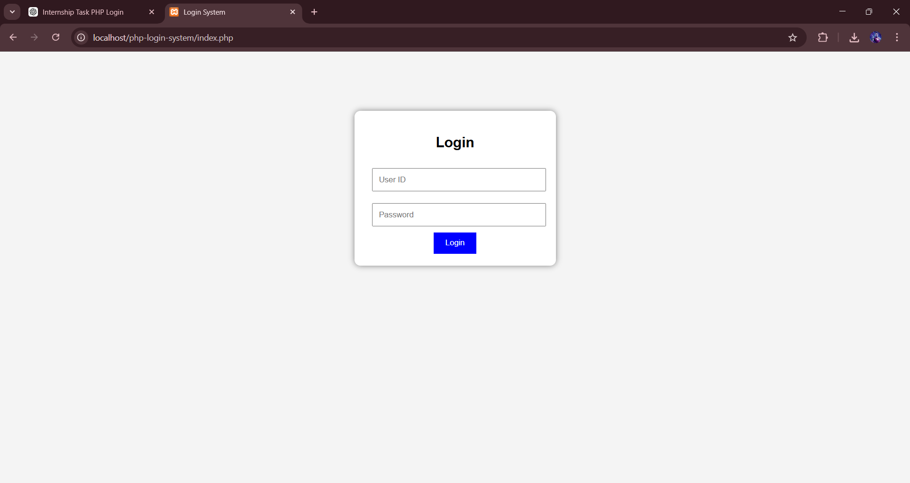
System Architecture
User
↓
Login Page
↓
Authentication (PHP)
↓
Database Verification (MySQL)
↓
Dashboard
↓
Products → Cart → Logout

Slide 5
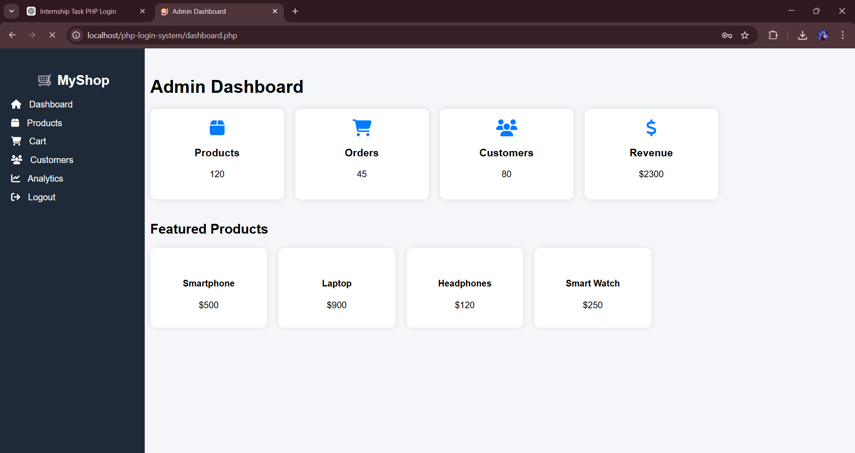
Dashboard Interface
After login, the user is redirected to a dashboard.
The dashboard contains navigation sidebar,
product statistics, and featured products.

Slide 6
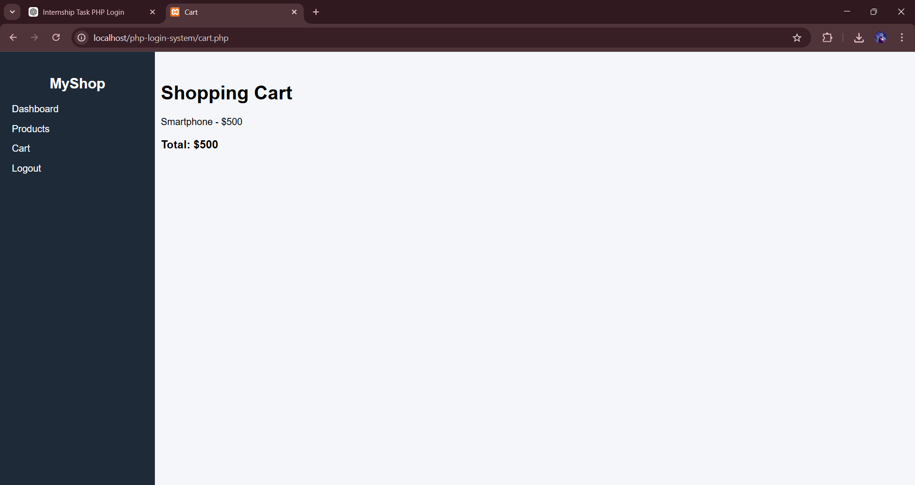
Product and Cart System
Users can browse products and add them to cart.
The cart page stores selected products using
PHP session variables and calculates the total price.

Slide 7
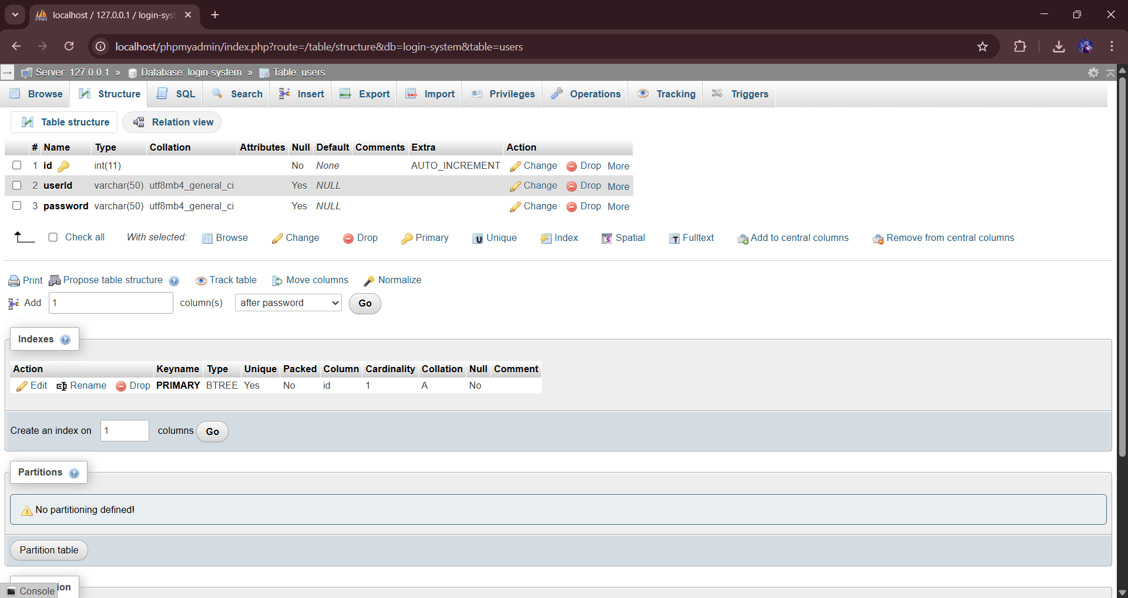
Database Structure
The project uses MySQL database to store user credentials.
Database Name: login-system
Table: users
Fields:
• id
• userId
• password

